Slide 1
Power BI
Big Data Analytics and Techniques

Slide 2


What is power bi?
Power BI is a business intelligence (BI) platform that provides nontechnical business users with tools for aggregating, analyzing, visualizing, and sharing data. It is a cloud-based platform, but it also includes a desktop application called Power BI Desktop.

Slide 3
Features
Power BI includes a wide range of features for data analysis and visualization, including:
Data connectors: Power BI can connect to a wide variety of data sources, including Excel, CSV files, SQL databases, and cloud-based data warehouses.
Data modeling: Power BI allows users to create data models that can be used to analyze and visualize data from multiple sources.
Visualizations: Power BI includes a wide range of visualization tools, including charts, graphs, maps, and dashboards.
Sharing: Power BI reports can be shared with others via the web, email, or mobile devices.

Slide 4
Benefits
Power BI offers several benefits for businesses, including:
Increased data visibility: Power BI makes it easy to see and understand data from multiple sources.
Improved decision-making: Power BI can help businesses make better decisions by providing insights into their data.
Increased productivity: Power BI can help businesses save time and resources by automating data analysis and visualization tasks.

Slide 5
DATABASE
Connecting Database (SQL, Excel, Text, Web)
Analyzing Tables & Relations – column and rows relations
Data Cleaning – Power Query Editor: - DAX (Language) - inside the power Bi
Developing Model – Inter relation diagram model.
Creating Dashboard

Slide 6
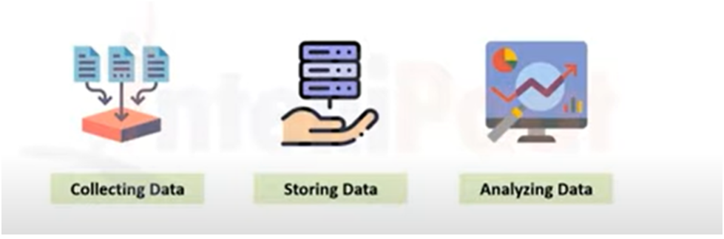


Business Intelligence
Business Intelligence is a set of processes in which data is stored by using different technologies for data analysis or future decision-making.

Slide 7





Tool for Business Intelligence

Slide 8
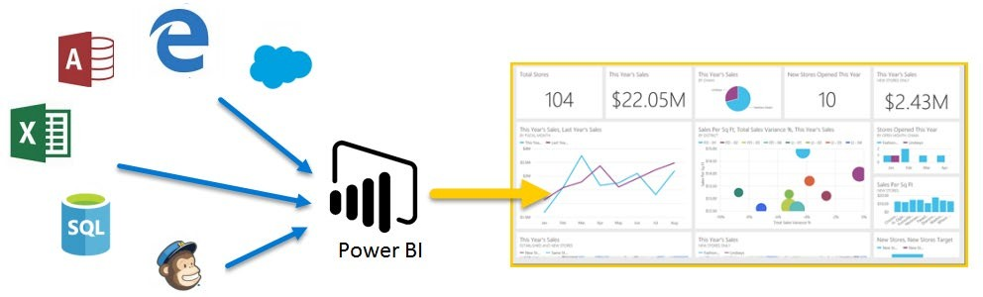
PowerBI
Power BI is a suite of business analytics tools which connects to different data sources to analyze data and share insights throughout your organization.

Slide 9
Power BI
Power BI is a business intelligence tool
It is used for data visualization, data analysis
Create Interactive Dashboards and BI reports.

Slide 10
Parts of Power BI
There are 3 Parts of Power BI.
Power BI Desktop
Power BI Service
Power BI Mobile
Power BI Desktop: It is a Windows desktop application (Report Authoring Tool) which Lets you build queries, models and reports that visualize data.
Power BI Service: Power BI Service is cloud based Software as Service Application which allows us to create dashboards, Setup schedule data refreshes, Share the reports securely in the organization.
Power BI Mobile: It is an application (App) on mobile devices which allows you to interact with the reports and dashboard from Power BI Service.

Slide 11
Power BI Desktop Interface: The Report has five main areas:
Ribbon: The Ribbon displays common tasks associated with reports and visualizations;
Pages: The Pages tab area along the bottom allows you to select or add a report page;
Visualizations: The Visualizations pane allows you to change visualizations, customize colors or axes, apply filters, drag fields, and more;
Fields: The Fields pane, allows you to drag and drop query elements and filters onto the Report view, or drag to the Filters area of the Visualizations pane;
Views Pane: There are three types of views in the views pane
Reports View – allows you to create any number of report pages with visualizations.
Data View – allows you to inspect, explore, and understand data in your Power BI Desktop model.
Relationship or Model view – allows you to show all of the tables, columns, and relationships in your model.

Slide 12
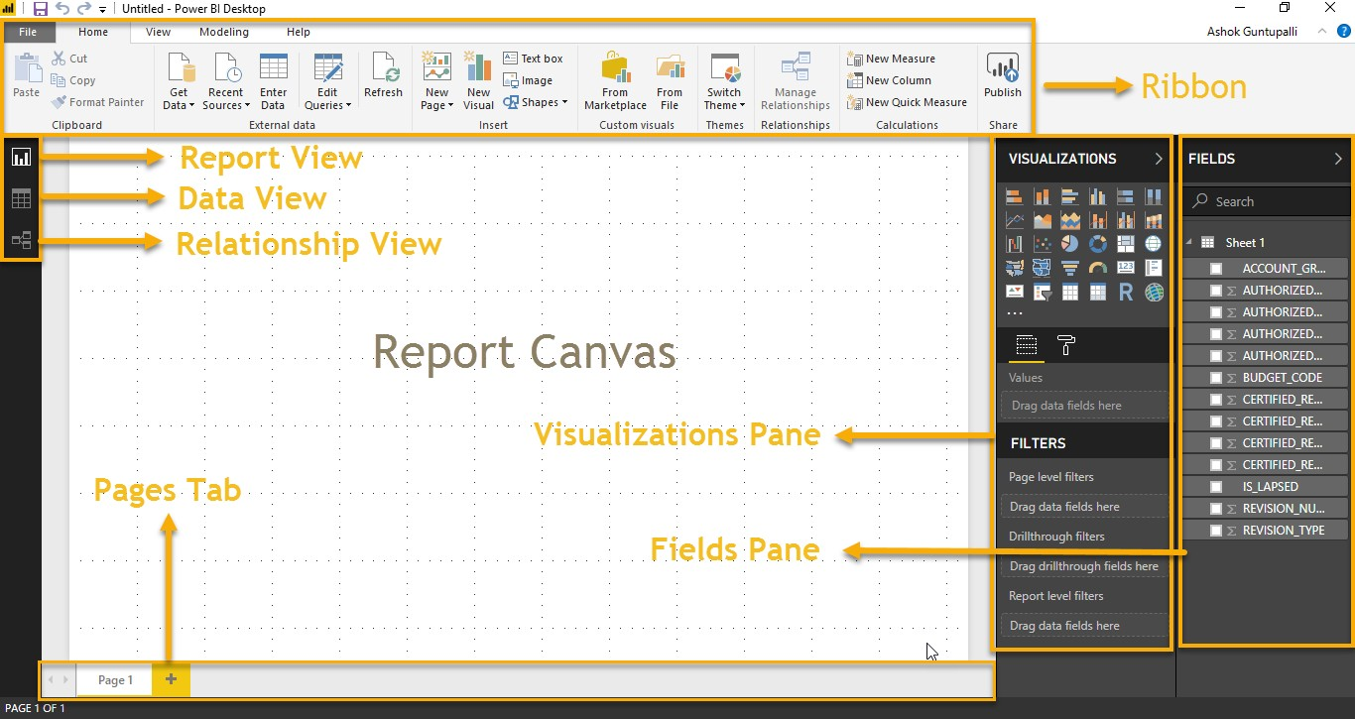

Slide 13
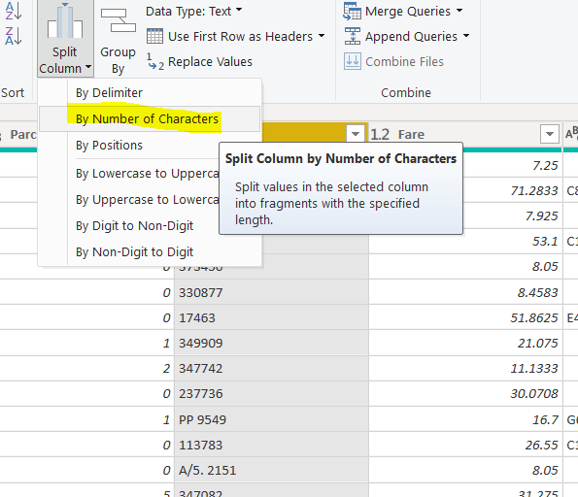

Power BI Components

Slide 14

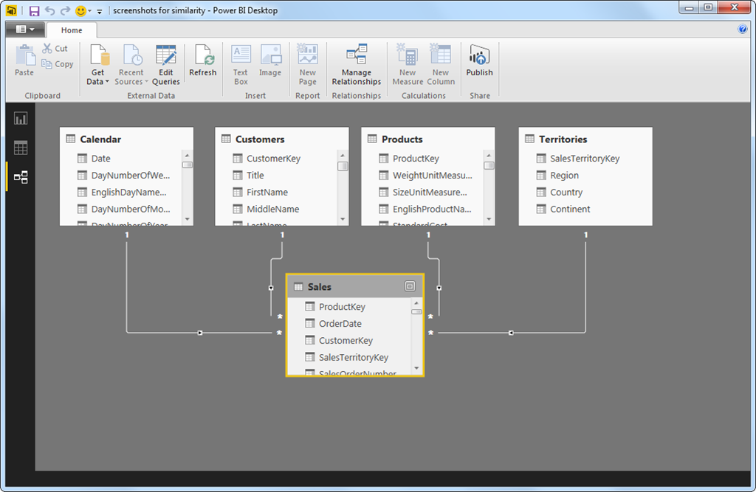

Slide 15
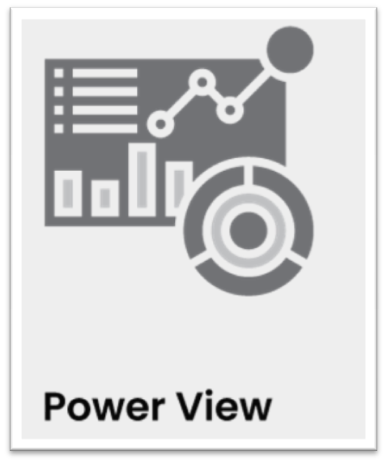
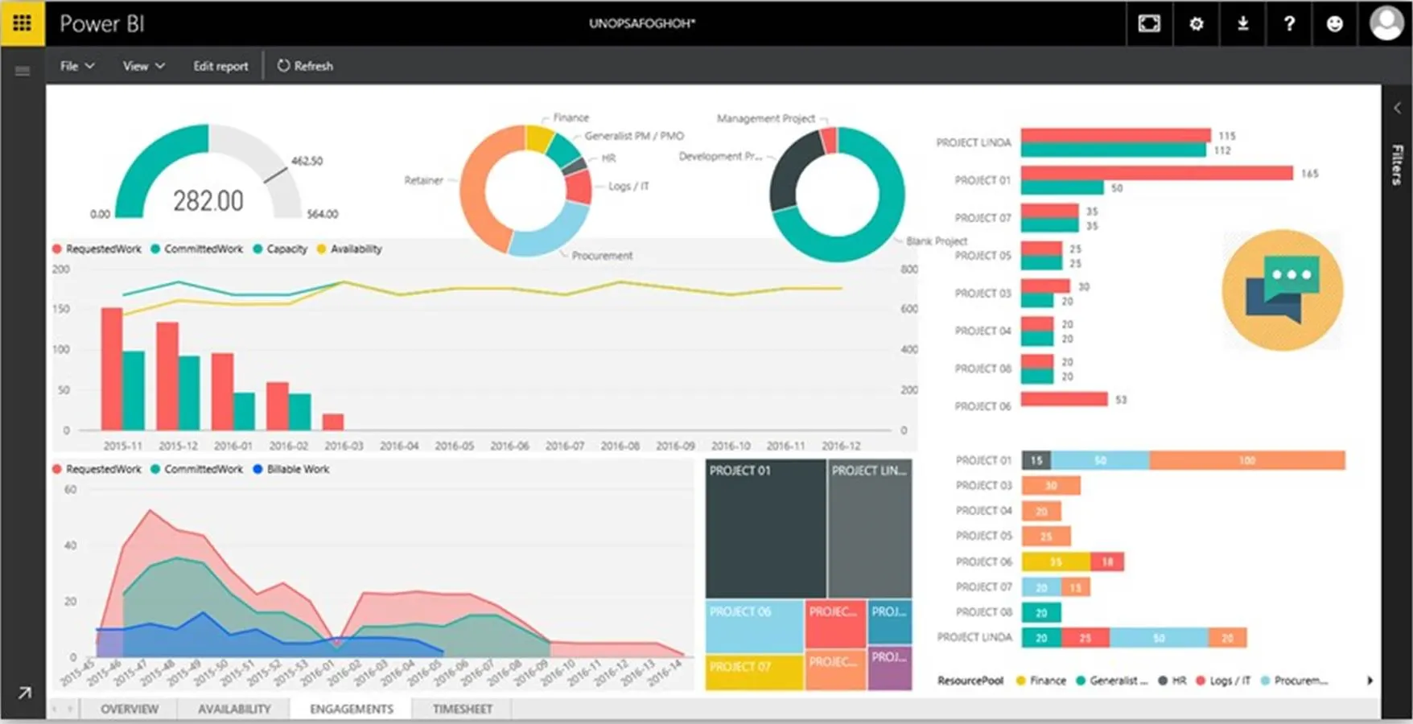

Slide 16
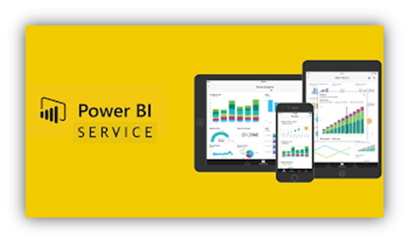
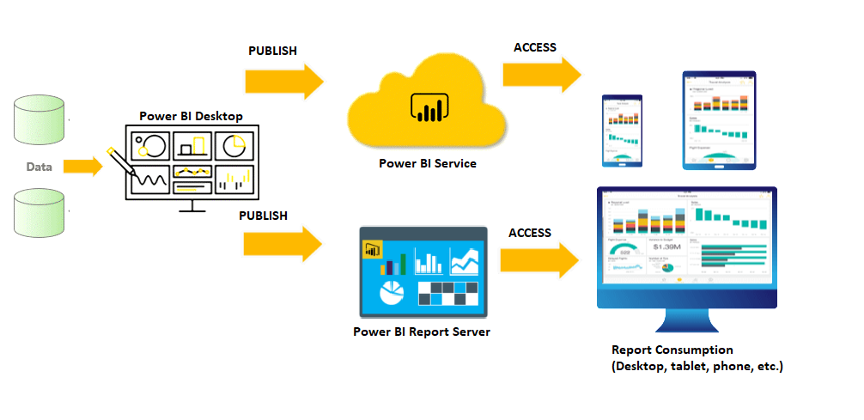

Slide 17
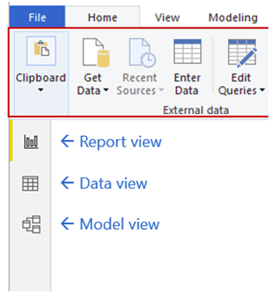

Slide 18
Basic Charts
Column Chart
Donut Chart
Stacked Column Chart
Funnel Chart
Pie Chart
Ribbon Chart

Slide 19
Create Map
Area Chart
Insert image
Create table
Tree Map
Cards
Line chart
Gauge Chart
Slicers

Slide 20
Power BI PROJECT ON DATA Analysis
Big Data Analytics and Techniques

Slide 21
